Slide 1
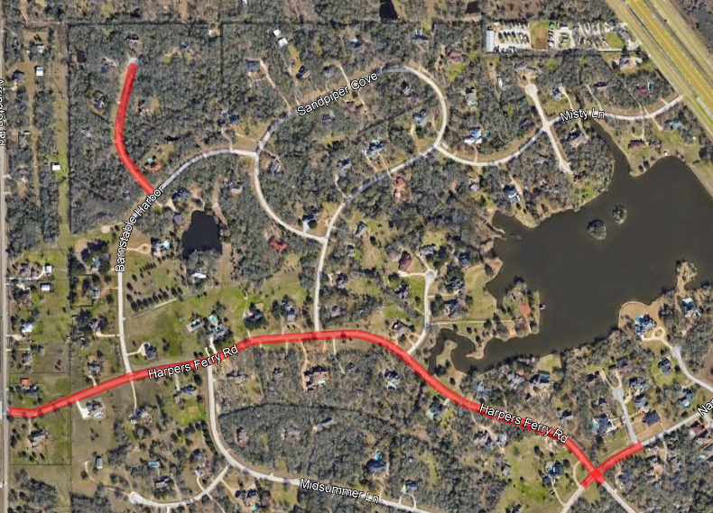
Harpers Ferry Road and Cricket Pass Reconstruction
Forest Ridge Elementary
Monday, March 25, 2024
Mason Kwiatkowski, P.E. - GLS
Fred Paine, P.E. – Brazos County Road & Bridge

Slide 2
Agenda
Existing Roadway Conditions
Key Design Items
Roadway Demolition
Proposed Reconstruction
Construction Expectations
Detour Routes
Discussion and Questions

Slide 3
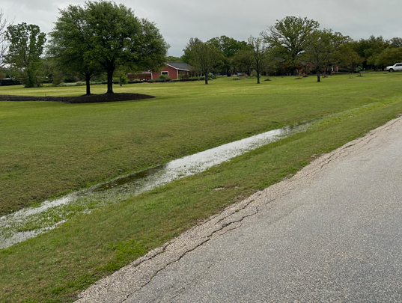
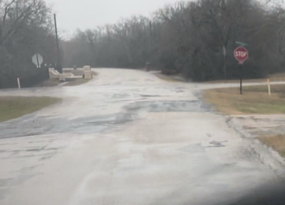
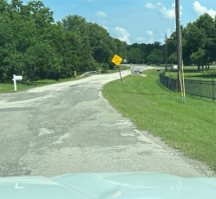
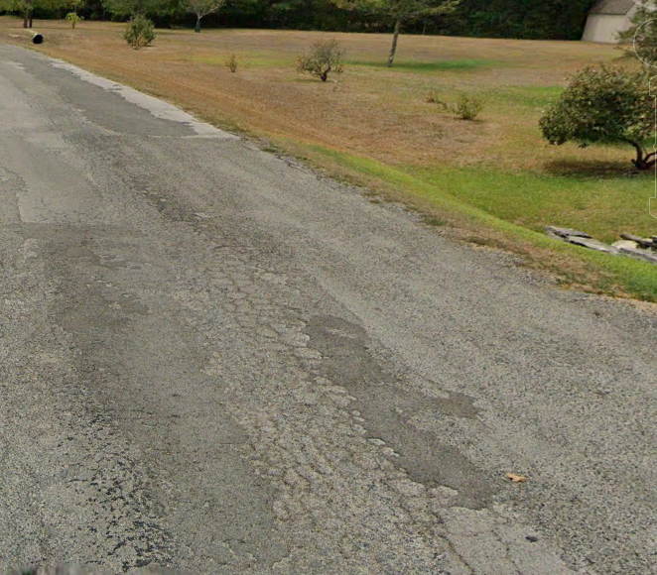
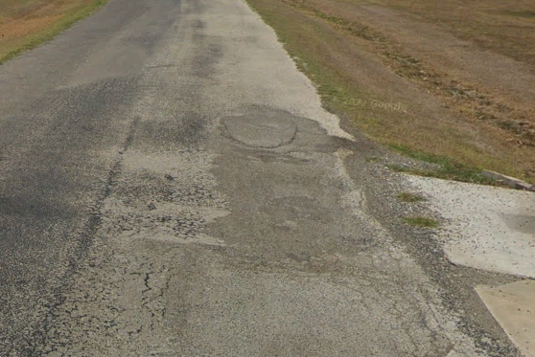
Existing Roadway Harpers Ferry
Pavement Failure
Ditch Grading

Slide 4
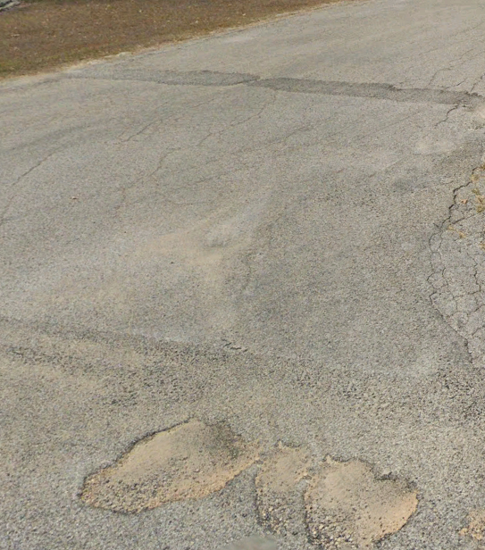
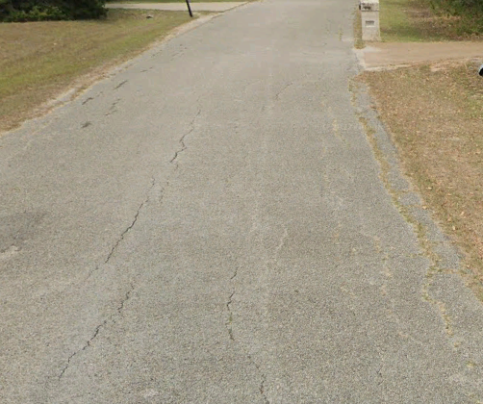
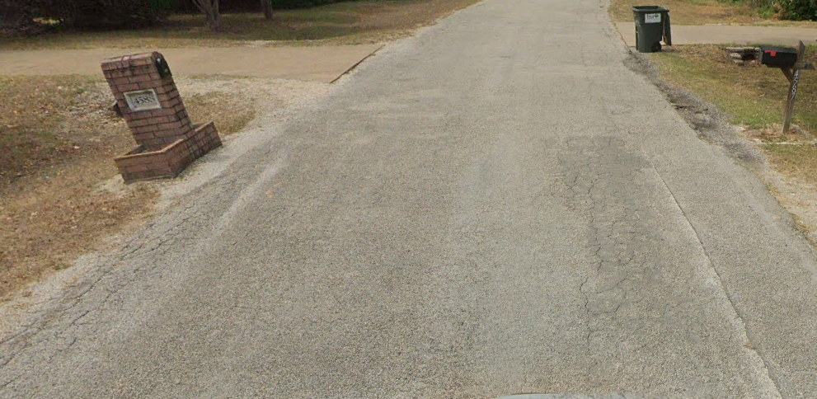
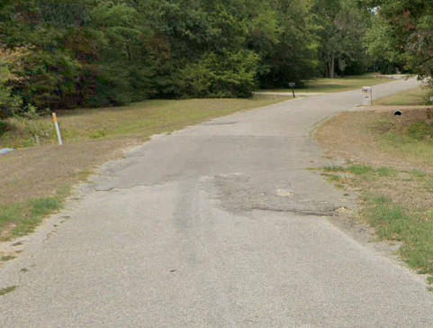
Existing Roadway Cricket Pass
Pavement Failure

Slide 5
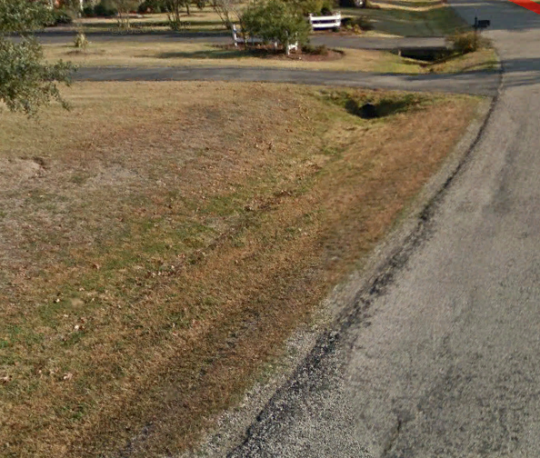
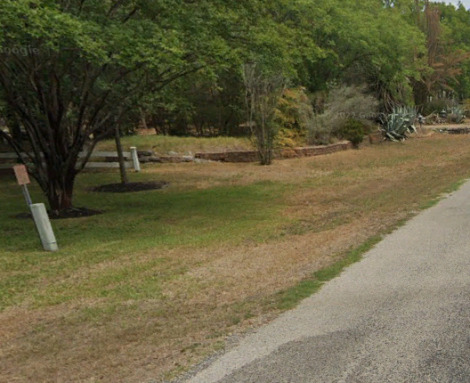
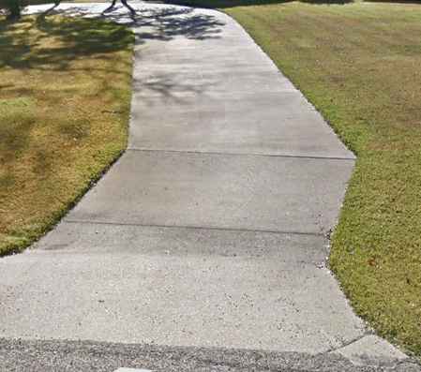
Key Design Items
Value of Aesthetics
Maintainable Ditches
Driveways

Slide 6
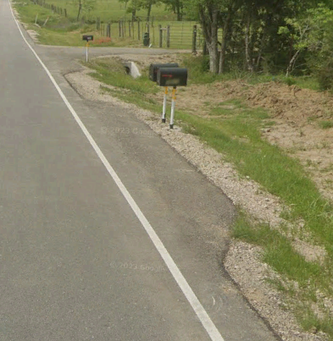
Roadway Demolition
Asphalt and base material will be demolished and hauled off site
All mailboxes will be removed and replaced with TxDOT standard mailboxes
Notes:
Have not had great success with resetting the existing mailboxes. Contractor can leave demo’ed brick on the property if desired.

Slide 7
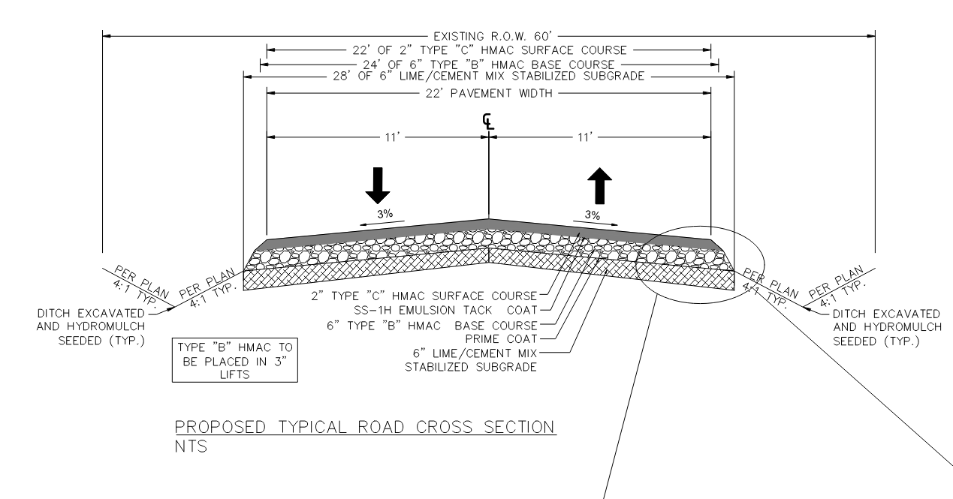
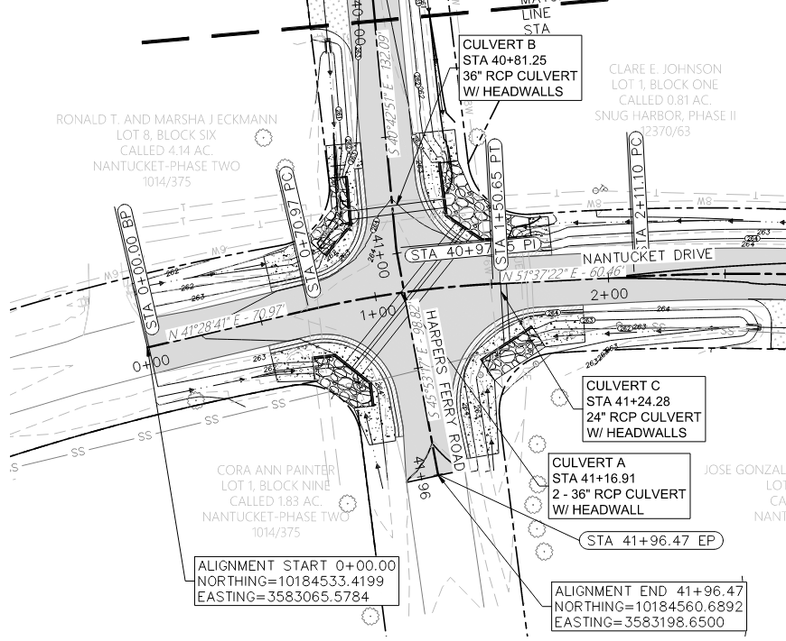
Proposed Reconstruction Harpers Ferry
Pavement to be widened to 22’ wide asphalt (20’ existing)
Slurry mix to be used for subgrade stabilization to control dust
Driveways to be reconstructed as asphalt. Driveway culverts to be replaced with RCP pipe
Mailboxes turnouts will be provided
Drainage structures to be replaced
Guardrails will be provided at radiuses of Harpers Ferry and Nantucket intersection
Notes:
Discuss concrete potentially be provided as an alternate. Will not be decorative. If homeowner decides to have decorative concrete, contractor can provide base material only. Homeowner can have their own contractor pour decorative concrete

Slide 8
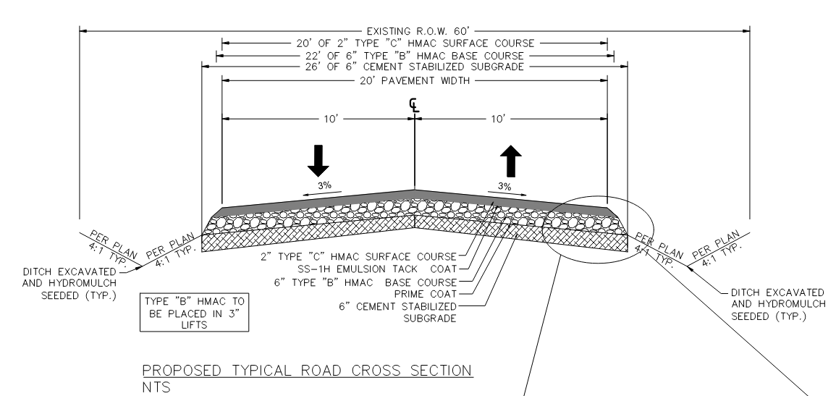
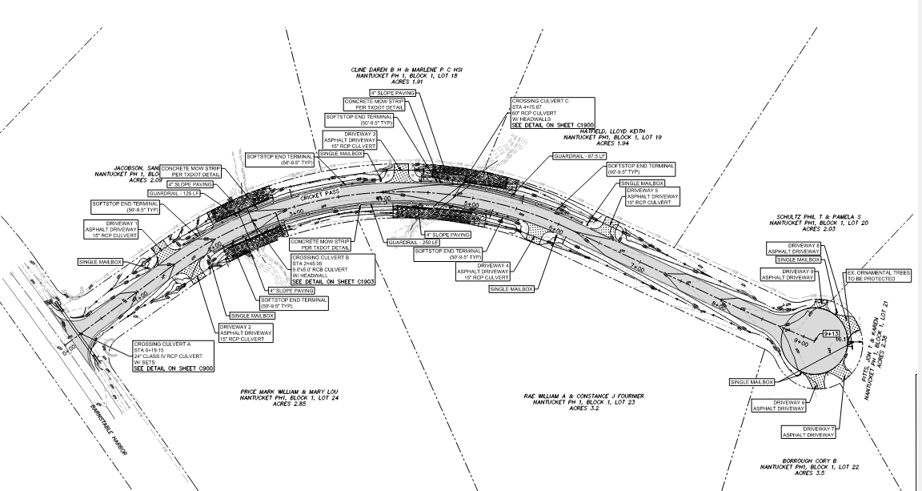
Proposed Reconstruction Cricket Pass
Pavement to be widened to 20’ wide asphalt (18-19’ existing)
Slurry mix to be used for subgrade stabilization to control dust
Driveways to be reconstructed as asphalt. Driveway culverts to be replaced with RCP pipe
Drainage structures to be replaced
Guardrails will be provided near culvert crossings
Notes:
Discuss concrete potentially be provided as an alternate. Will not be decorative. If homeowner decides to have decorative concrete, contractor can provide base material only. Homeowner can have their own contractor pour decorative concrete

Slide 9
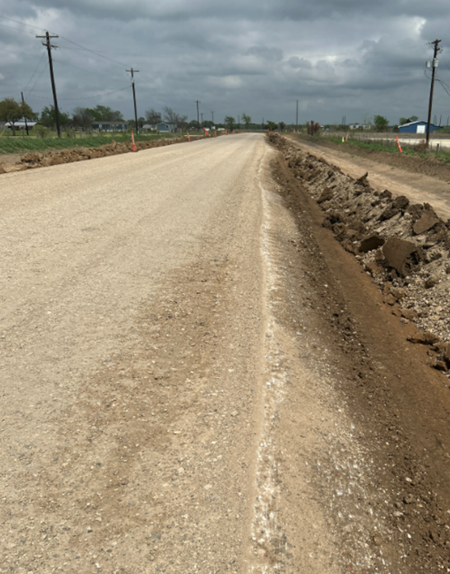
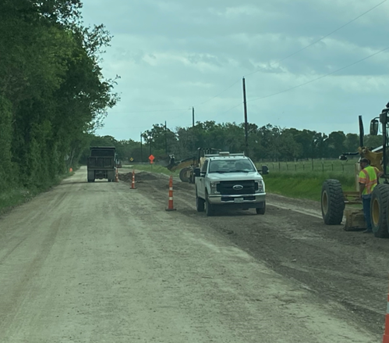
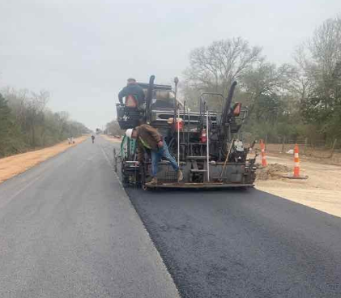
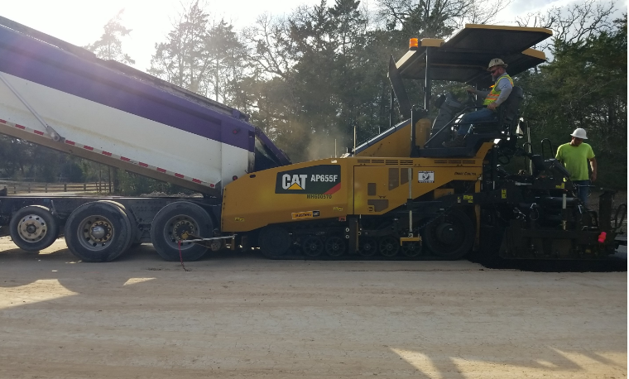
Construction Expectations
Construction begins Summer 2024
Construction will be performed in three phases
Complete in Fall 2024
Expectations during construction – Local traffic will have gravel road access to their respective property.

Slide 10
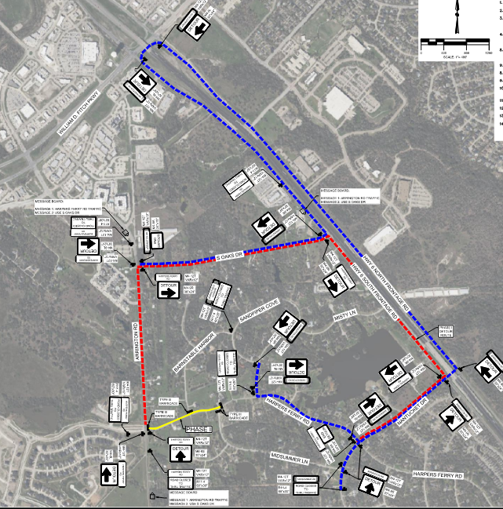
Detour Routes Phase 1
Road closed from Harpers Ferry & Arrington intersection to Harpers Ferry & Midsummer Lane intersection
Traffic Routed to South Oaks

Slide 11
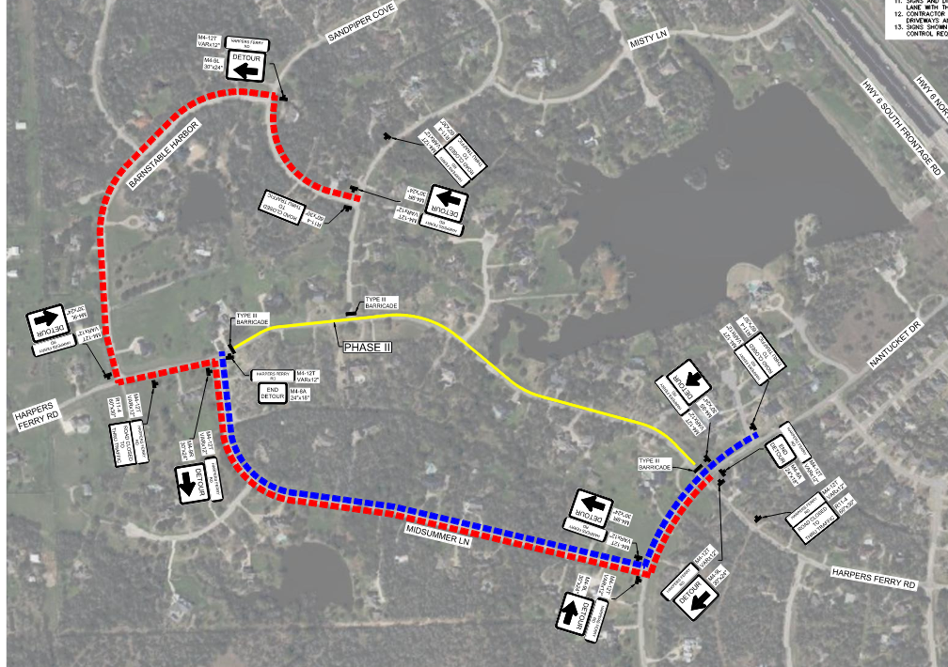
Detour Routes Phase 2
Road closed from Harpers Ferry & Midsummer Lane intersection to Harpers Ferry & Nantucket intersection
Traffic Routed to Midsummer Lane

Slide 12
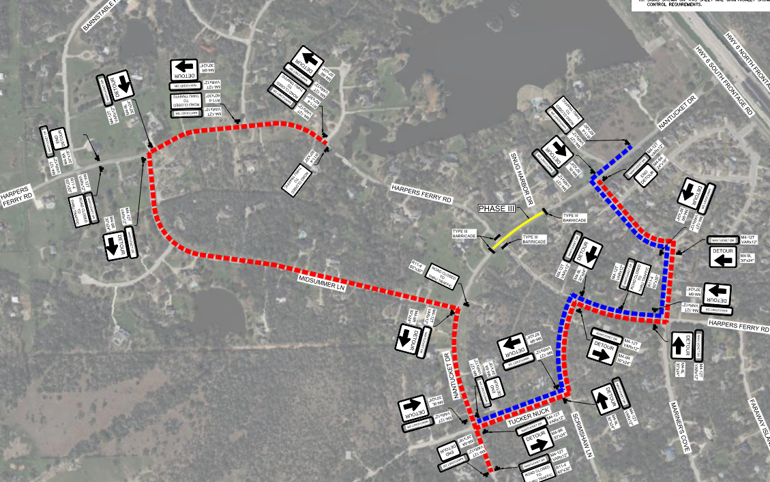
Detour Routes Phase 3
Road closed at Harpers Ferry & Nantucket intersection
Traffic Routed to Mariner’s Cove & Midsummer Lane

Slide 13
Questions & Discussion
Notes:
Presentation will be emailed upon request

